Slide 1
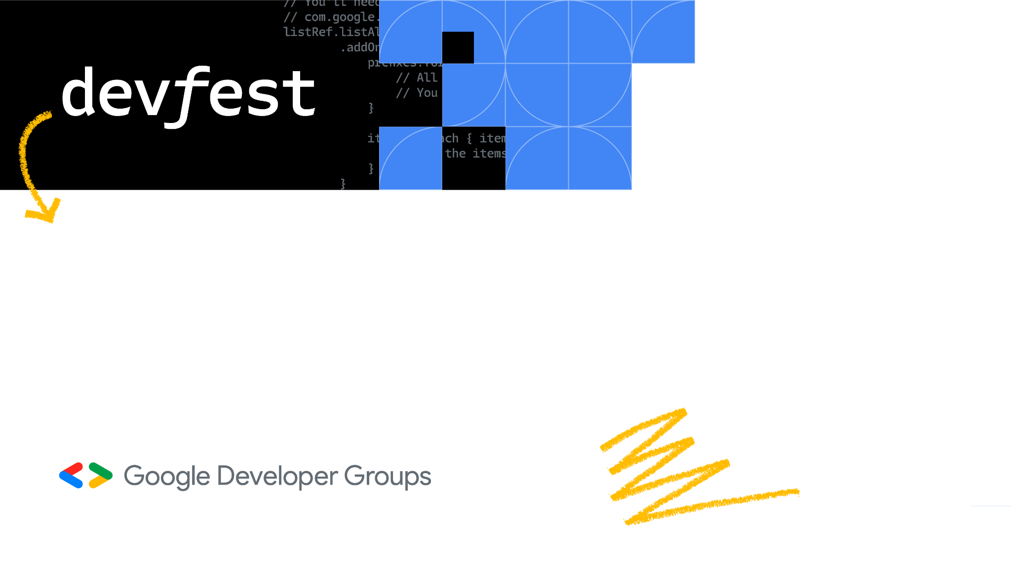
Mediapipe 入门
Eliyar Eziz
Beijing

Slide 2
Mediapipe 介绍

Slide 3
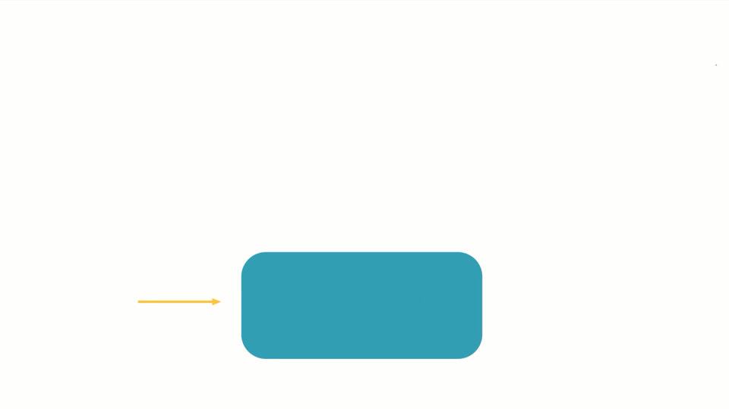
规则
传统编程
输入
输出

Slide 4
输出
ML 模型
输入
规则

Slide 5


设备端 机器学习
降低延迟
离线可用
保护隐私
节约成本

Slide 6
ML app
Input
模型 是设备端机器学习
解决方案的核心
Model Inference
轻量且高效
针对硬件进行优化
稀疏化以获得最佳性能
Output

Slide 7
ML app
Live Camera
Flow Control
ML Pipeline 是将原始输入转化成结果的过程
Data Preprocessing
Model Inference
领域特定处理（例如视觉/自然语言处理/音频）
CPU / GPU / EdgeTPU / DSP的端到端加速
跨Android / iOS、Web、裸机的跨平台部署
Post-processing
Synchronization
Output

Slide 8
ML app
Live Camera
Buffer Management
Data Subsampling
Data Lifecycle
Flow Control
Image Filtering
Format Conversion
Timestamp Extraction
还有很多的复杂度
阻碍快速开发
Resource Caching
Data Preprocessing
Data Marshalling
Thread Management
GPU/CPU Data Transfer
Asset Loading
Model Inference
OpenGL ES
Timestamp Alignment
Cross-platform Abstraction
CPU Affinity
Post-processing
C++ Programming
Java Native Interface
Multi-threaded GPU Compute
Trace Collection
Synchronization
iOS Metal
GPU Timing Measurement
Performance Profiling
Display

Slide 9
ML app
Live Camera
MediaPipe Tasks
Flow Control
MediaPipe 通过抽象这个复杂度为 MediaPipe Tasks
加速开发过程
Data Preprocessing
Model Inference
Post-processing
Synchronization
Display

Slide 10
ML app
Live Camera
Flow Control
同时也可以使用
MediaPipe Model Maker
自定义模型来实现特定任务
MediaPipe
Model Maker
Data Preprocessing
Model Inference
Custom model
Post-processing
Synchronization
Display

Slide 11
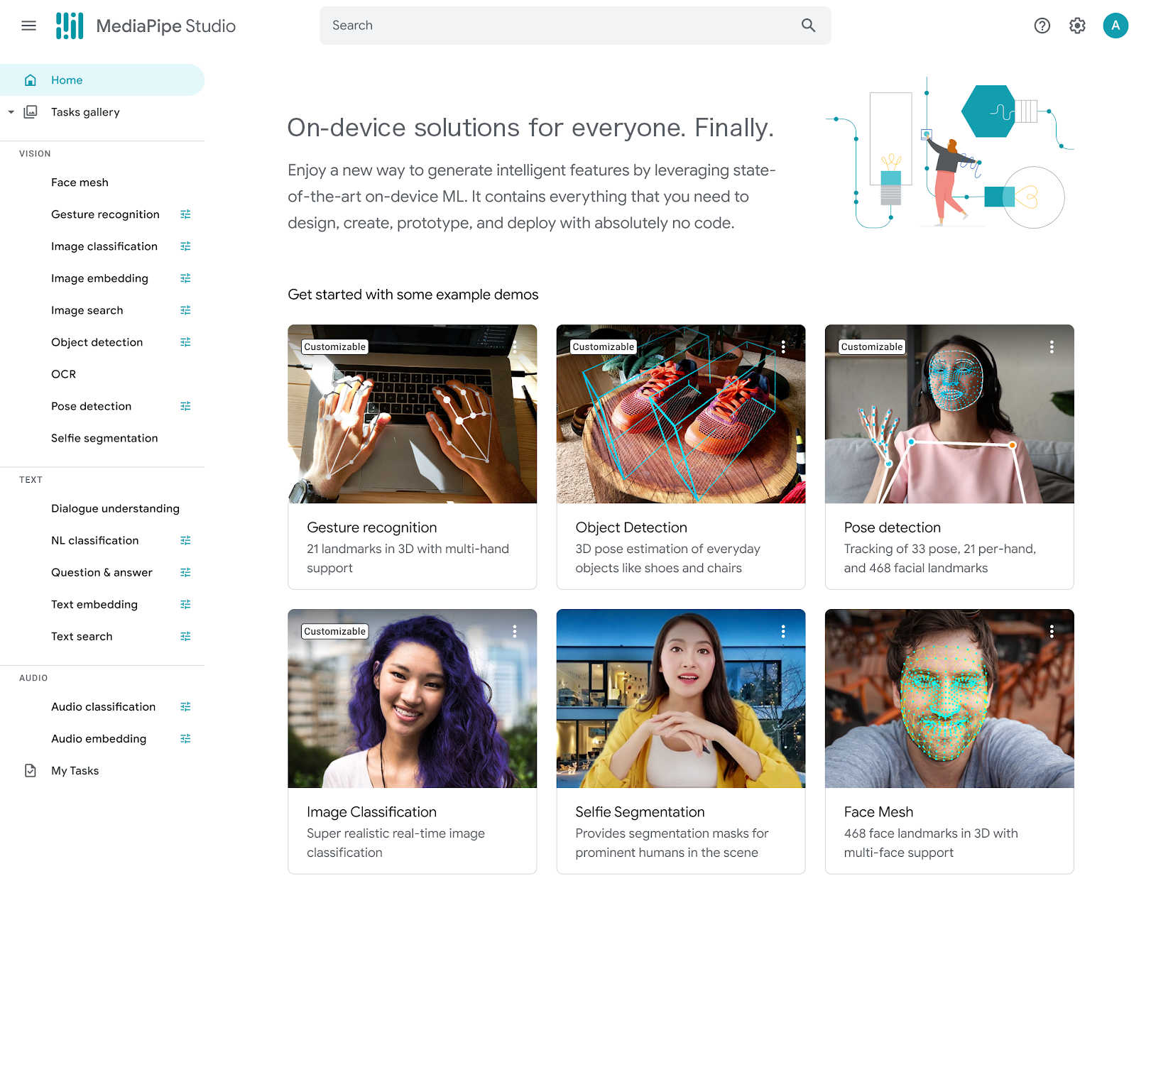
MediaPipe Studio

Slide 12
图像分类

Slide 13
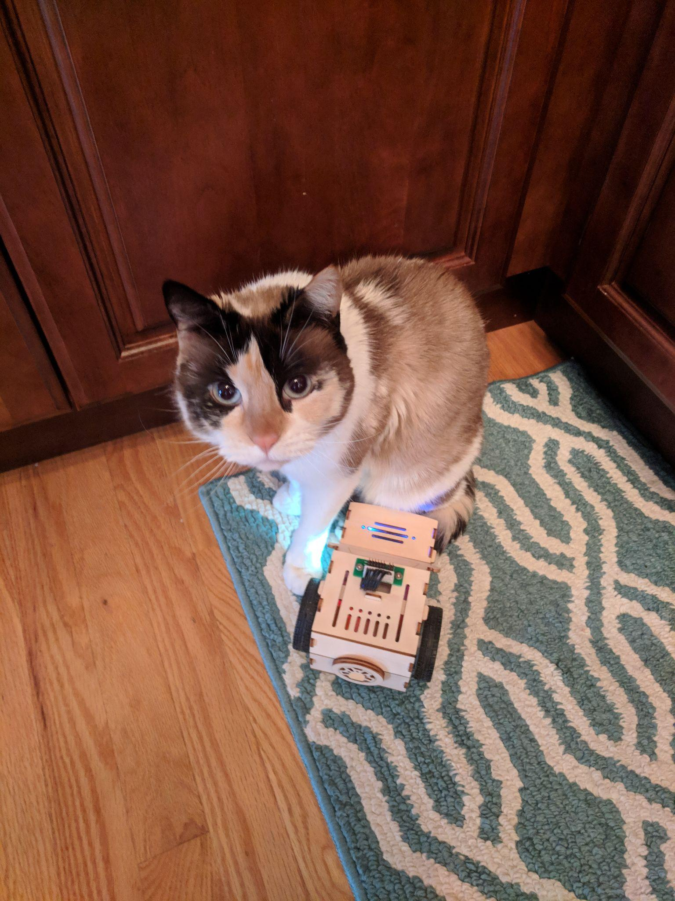
Cat

Slide 14
Cat
Rug
Toy

Slide 15
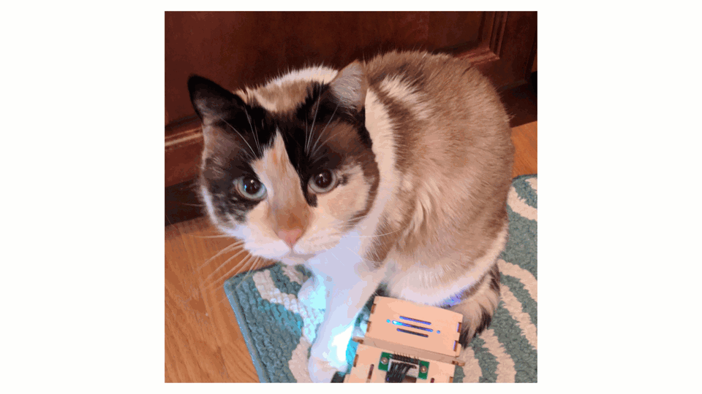

Slide 16
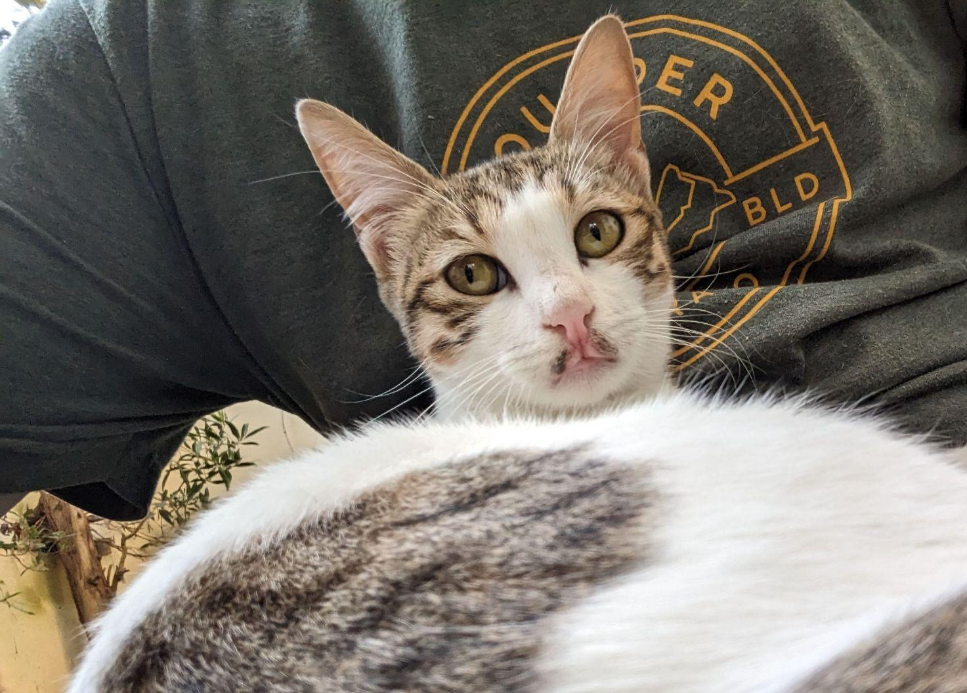

Slide 17
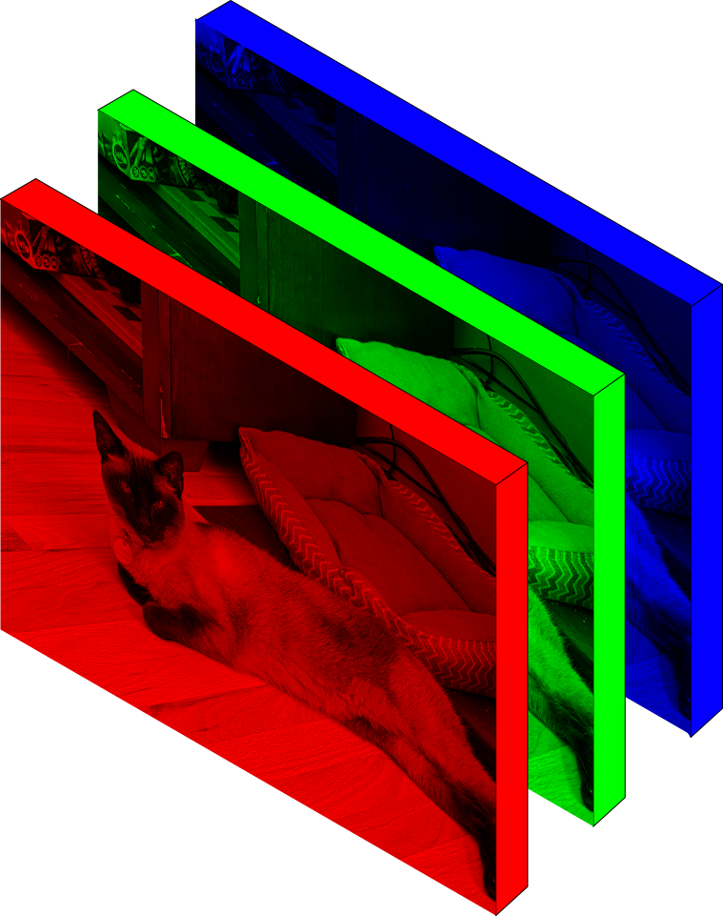

Slide 19
pip install mediapipe

Slide 20
wget -O classifier.tflite -q MODEL_URL

Slide 21
import mediapipe as mp
from mediapipe.tasks import python
from mediapipe.tasks.python import vision

Slide 22
base_options = python.BaseOptions(model_asset_path=model)
options = vision.ImageClassifierOptions(
base_options=base_options,
max_results=max_results,
score_threshold=score_threshold,
result_callback=save_result,
running_mode=vision.RunningMode.LIVE_STREAM)

Slide 23
base_options = python.BaseOptions(model_asset_path=model)
options = vision.ImageClassifierOptions(
base_options=base_options,
max_results=max_results,
score_threshold=score_threshold,
result_callback=save_result,
running_mode=vision.RunningMode.LIVE_STREAM)

Slide 24
base_options = python.BaseOptions(model_asset_path=model)
options = vision.ImageClassifierOptions(
base_options=base_options,
max_results=max_results,
score_threshold=score_threshold,
result_callback=save_result,
running_mode=vision.RunningMode.LIVE_STREAM)

Slide 25
base_options = python.BaseOptions(model_asset_path=model)
options = vision.ImageClassifierOptions(
base_options=base_options,
max_results=max_results,
score_threshold=score_threshold,
result_callback=save_result,
running_mode=vision.RunningMode.LIVE_STREAM)

Slide 26
base_options = python.BaseOptions(model_asset_path=model)
options = vision.ImageClassifierOptions(
base_options=base_options,
max_results=max_results,
score_threshold=score_threshold,
result_callback=save_result,
running_mode=vision.RunningMode.LIVE_STREAM)

Slide 27
classifier = vision.ImageClassifier.create_from_options(options)

Slide 28
rgb_image = cv2.cvtColor(image, cv2.COLOR_BGR2RGB)
mp_image = mp.Image(image_format=mp.ImageFormat.SRGB,
data=rgb_image)

Slide 29
classifier.classify_async(mp_image, time.time_ns())

Slide 30
ImageClassifierResult:
Classifications #0 (single classification head):
head index: 0
category #0:
category name: "/m/01bwb9"
display name: "Passer domesticus"
score: 0.91406
index: 671
category #1:
category name: "/m/01bwbt"
display name: "Passer montanus"
score: 0.00391
index: 670

Slide 31

手势识别
Editable Location

Slide 32
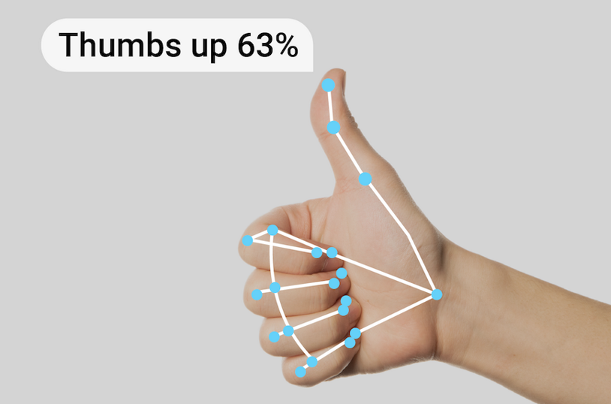
手势识别

Slide 33
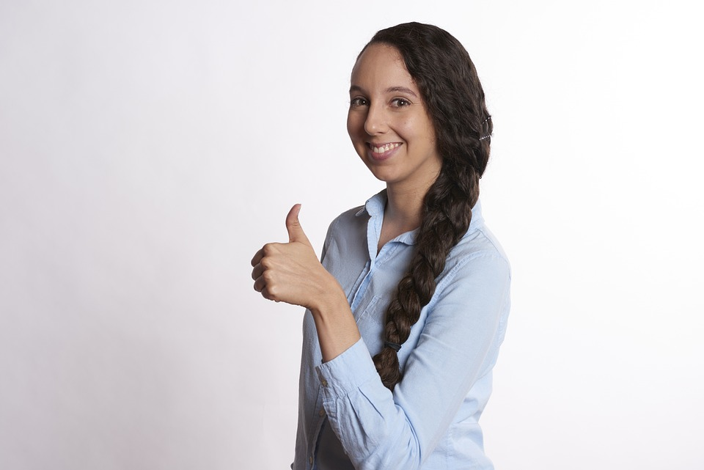
手势识别
1

Slide 34
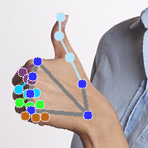
手势识别
2

Slide 35
手势识别
3
22
21
…
61
92

Slide 36
手势识别
4
Thumbs Up
22
21
…
61
92

Slide 37
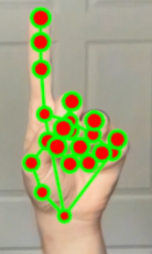
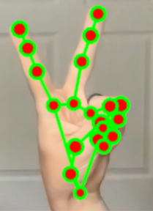
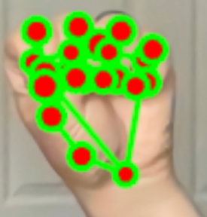
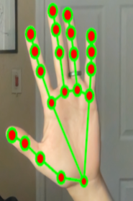
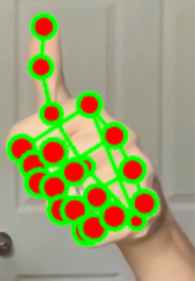
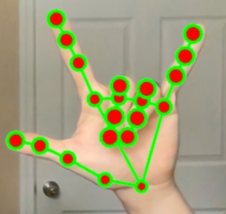
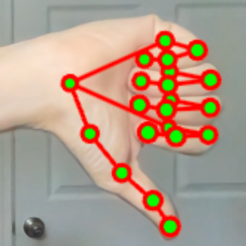
pointing_up
victory
closed_fist
open_palm
thumb_up
i_love_you
thumb_down

Slide 38
recognizer = vision.GestureRecognizer.create_from_options(options)

Slide 39
rgb_image = cv2.cvtColor(image, cv2.COLOR_BGR2RGB)
mp_image = mp.Image(
image_format=mp.ImageFormat.SRGB,
data=rgb_image)
recognizer.recognize_async(mp_image, time.time_ns())

Slide 40
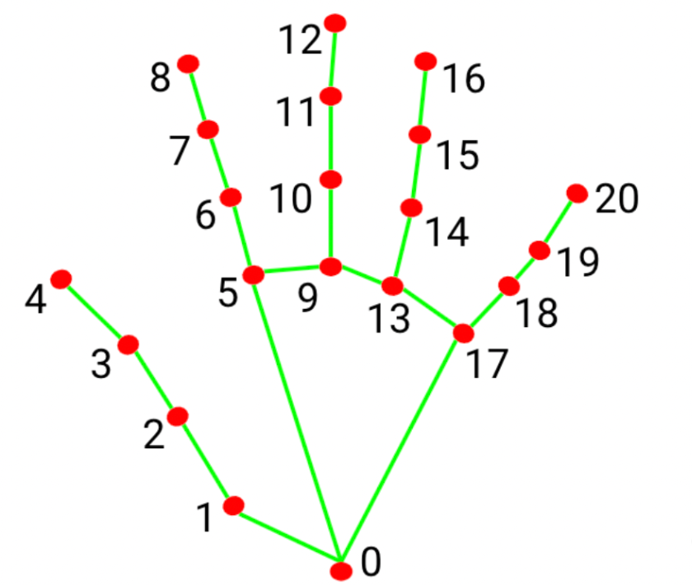
GestureRecognizerResult:
Handedness:
Categories #0:
index : 0
score : 0.98396
categoryName : Left
Gestures:
Categories #0:
score : 0.76893
categoryName : Thumb_Up
Landmarks:
Landmark #0:
x : 0.638852
y : 0.671197
z : -3.41E-7
... (21 landmarks for a hand)
WorldLandmarks:
... (21 world landmarks for a hand)

Slide 41
Landmarks:
Landmark #0:
x : 0.638852
y : 0.671197
z : -3.41E-7
Landmark #1:
x : 0.634599
y : 0.536441
z : -0.06984
... (21 landmarks for a hand)

Slide 42
WorldLandmarks:
Landmark #0:
x : 0.067485
y : 0.031084
z : 0.055223
Landmark #1:
x : 0.063209
y : -0.00382
z : 0.020920
... (21 landmarks for a hand)

Slide 43

更多例子
Editable Location

Slide 44
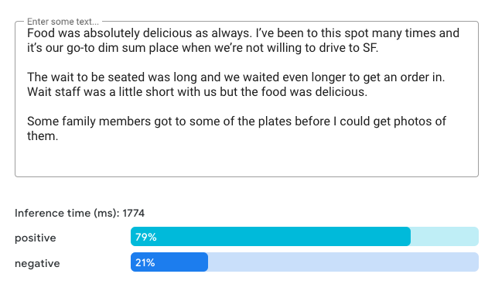
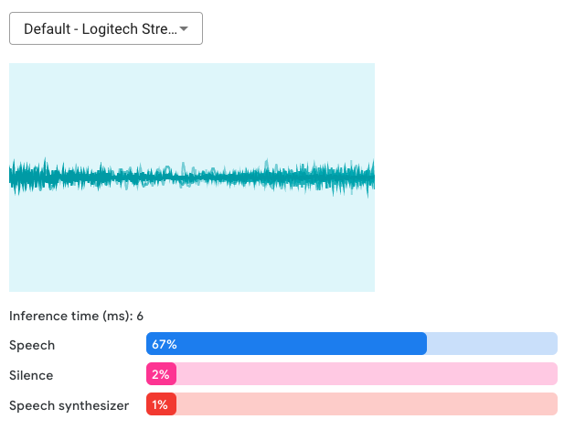
Text classification
Audio classification
https://goo.gle/mediapipe-studio

Slide 45


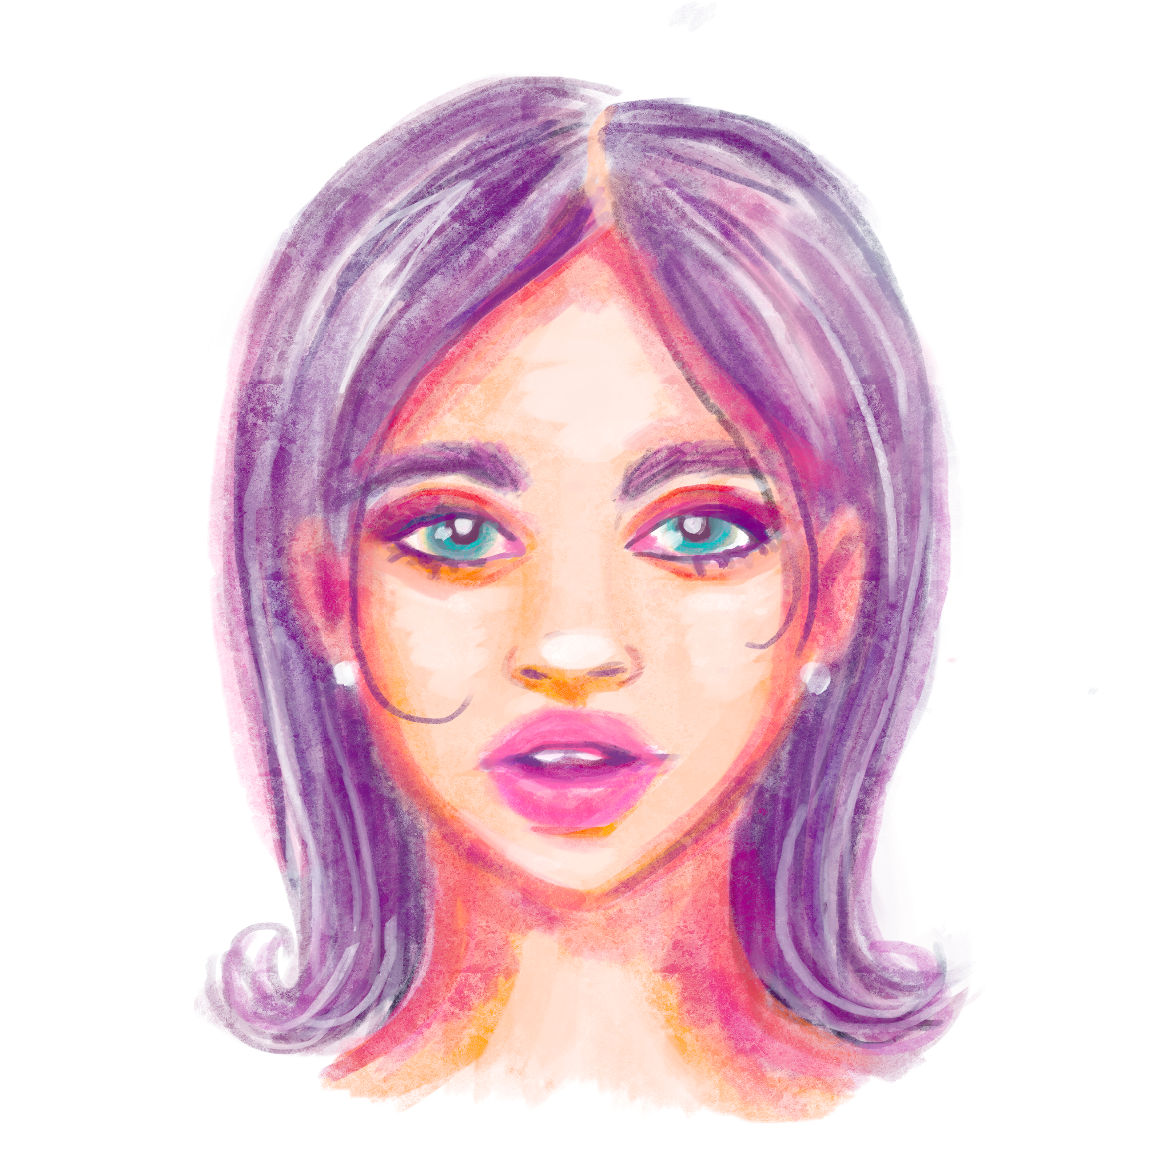
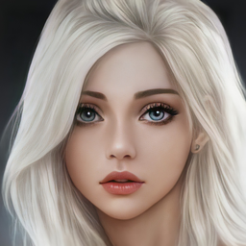
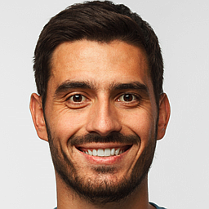
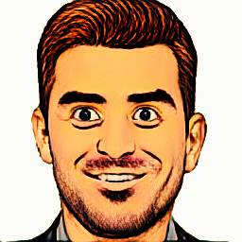
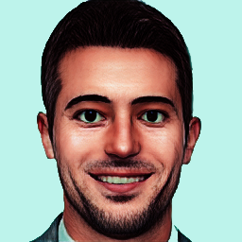

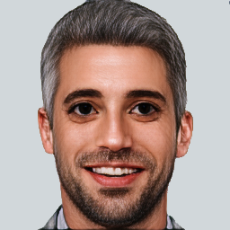
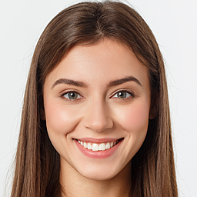
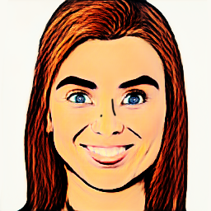
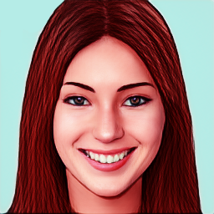
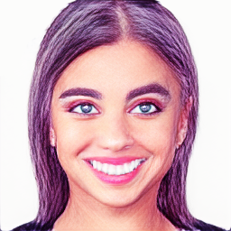
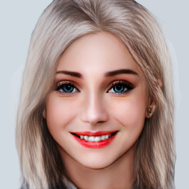
Style
Face stylization
Input face
* Please only use this solution on your face or faces of people who have given you permission to do so.

Slide 46


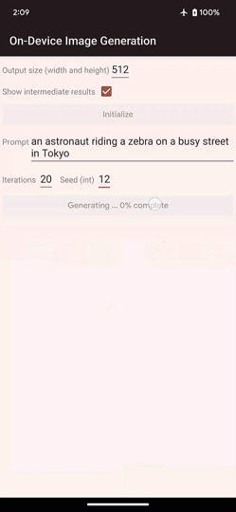
Text-to-image generation

Slide 47
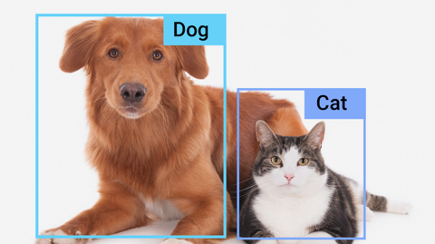
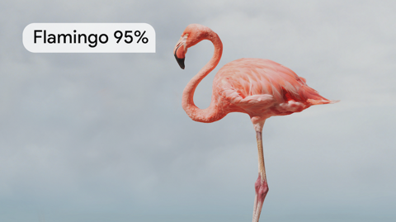

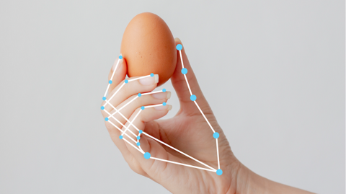
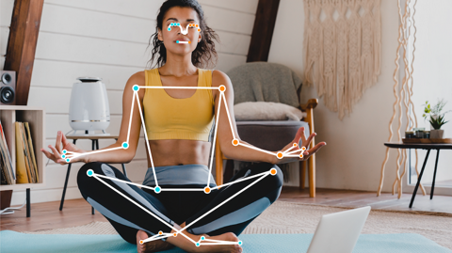
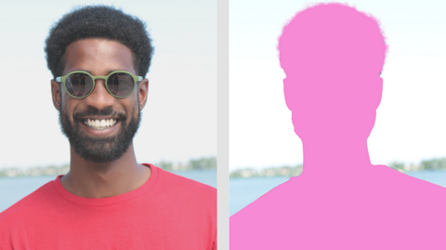
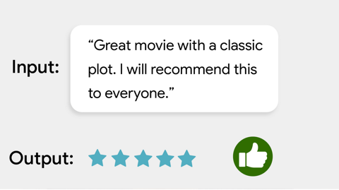
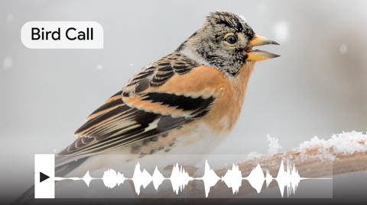
And many more!

Slide 48
Keep up to date
developers.google.com/mediapipe

